Slide 1
MIE 444 Proposal
Team 8
By Yi Ling, Vanessa, Jimin, Anchorage, Justin
Notes:
15s

Slide 2
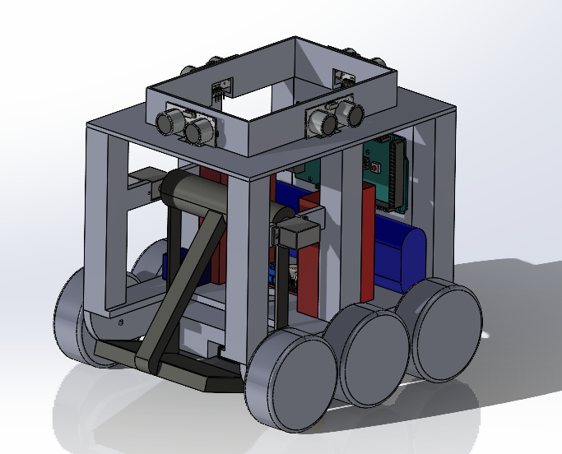
Introduction
Outline:
Manufacture and assembly
Pick up and block delivery
Electrical design sensor
Maze navigation
Obstacle avoidance
Localization
Maze planning
Notes:
Talk about team roles
15s

Slide 3

Manufacture and Assembly
Main components:
1x Arduino Mega
6x Wheels
2x Motor
1x Stepper Motor
2x Batteries
1x Breadboard
1x Bluetooth Module
4x Ultrasonic Sensor
2x IR Line Sensor
1x IR Distance Sensor
1x Limit Switch
1x Scooping Mechanism
Notes:
45s

Slide 4
Pick Up and Block Delivery
General steps
Drive to loading zone
IR Distance sensor to detect block
Scoop up block
Detect completion of scoop task with limit switch
Bluetooth transmits location B data
Drive to location B
Notes:
45s

Slide 5
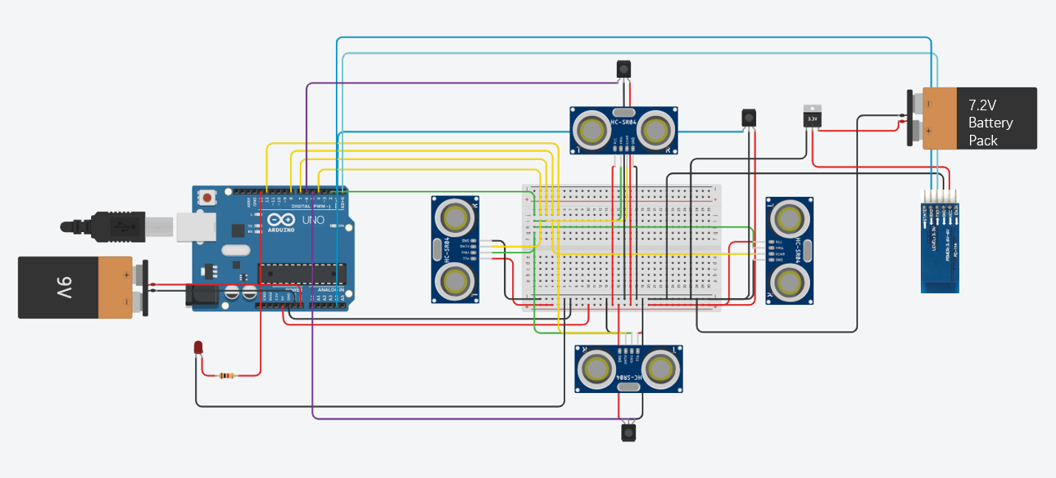
Electrical Design-Sensor
Notes:
30s
The electrical circuit is separated into sensor circuit and motor circuit for easier illustration, but the real design will use only one Arduino Mega. The 7.2V battery pack will power up the Bluetooth module, one 9V battery will power the Arduino and the other 9V battery will power the motor driver. Four ultrasonic sensors, sharing the same trigger pin, will provide distance data for localization and maze navigation. Two line tracking sensor will be used for localization, and one IR distance sensor will be used for detecting the block. One Bluetooth module will achieve wireless communication with the computer. A L298N motor driver will be used for the two DC motors for the wheels, and one servo motor will operate the scooping mechanism.

Slide 6
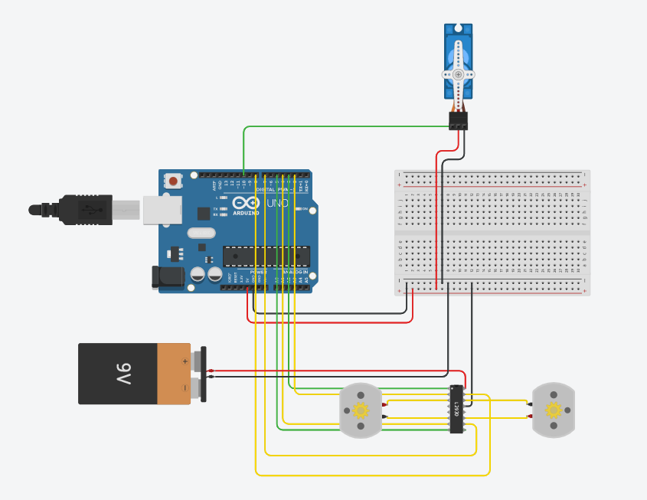
Electrical Design-2
Notes:
20s

Slide 7

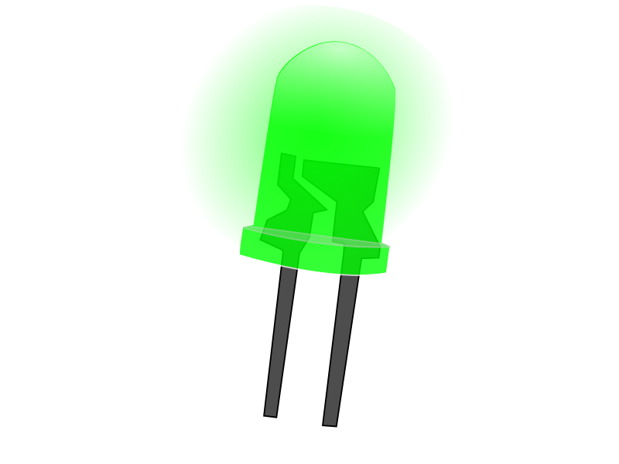
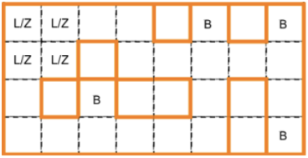
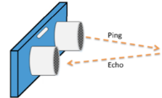
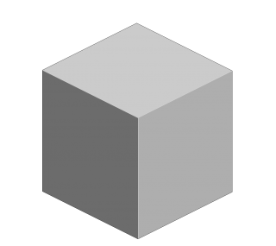
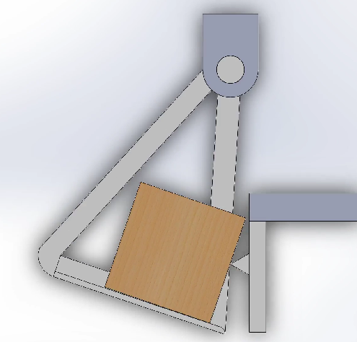
Maze Navigation
Unknown location
Move to L/Z
Move to Location B
Localize
Pick up block
Notes:
45s
For maze navigation, the robot will start at an unknown location. It will localize itself, apply motion planning to get to the loading zone, pick up the block, get to the final position, and then drop the block.

Slide 8
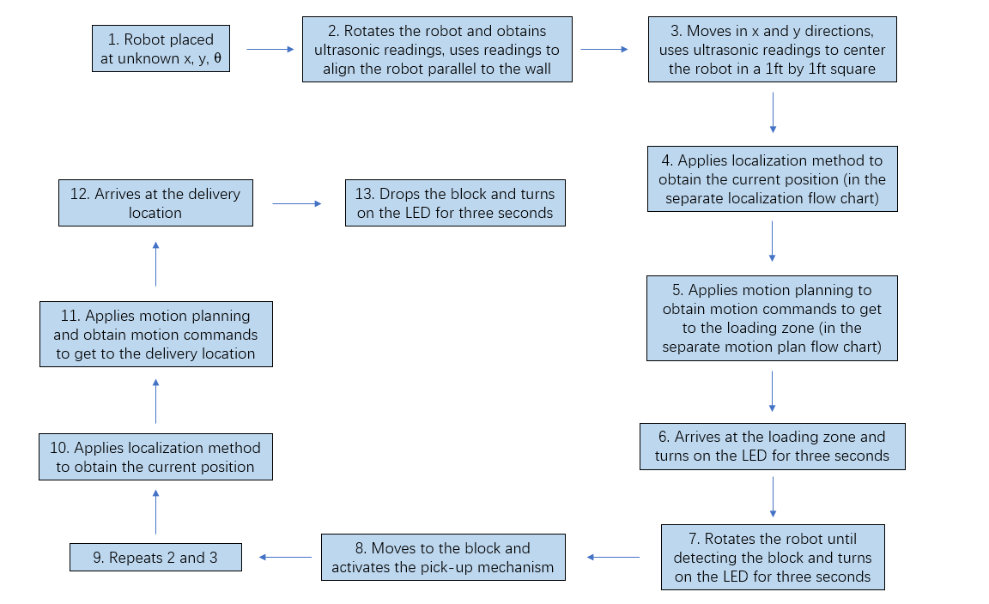
Maze Navigation

Slide 9
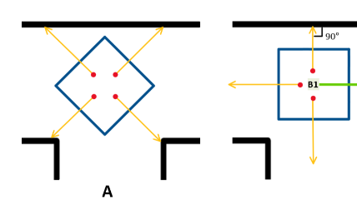
Obstacle Avoidance - Rotation
Rotates the robot such that robot is perpendicular/parallel to the wall
Steps:
First rotate in CW in 20° increments
If curr_distance < prev_distance: continue CW rotation
If curr_distance > prev_distance: CCW rotation by 10°
Notes:
For navigation, robot will first need to orient itself such that it is either perpendicular or parallel to walls.
This desired orientation will result sensors reading the minimum distance. Thus this can be achieved by Robot rotating clockwise in increments of 20 degrees where it will identify minimum distance by comparing current and previous distance measurements.
Prior to any rotation, collision will be avoided by securing the rover’s rotational clearance based on sensor readings and translations.
45s

Slide 10
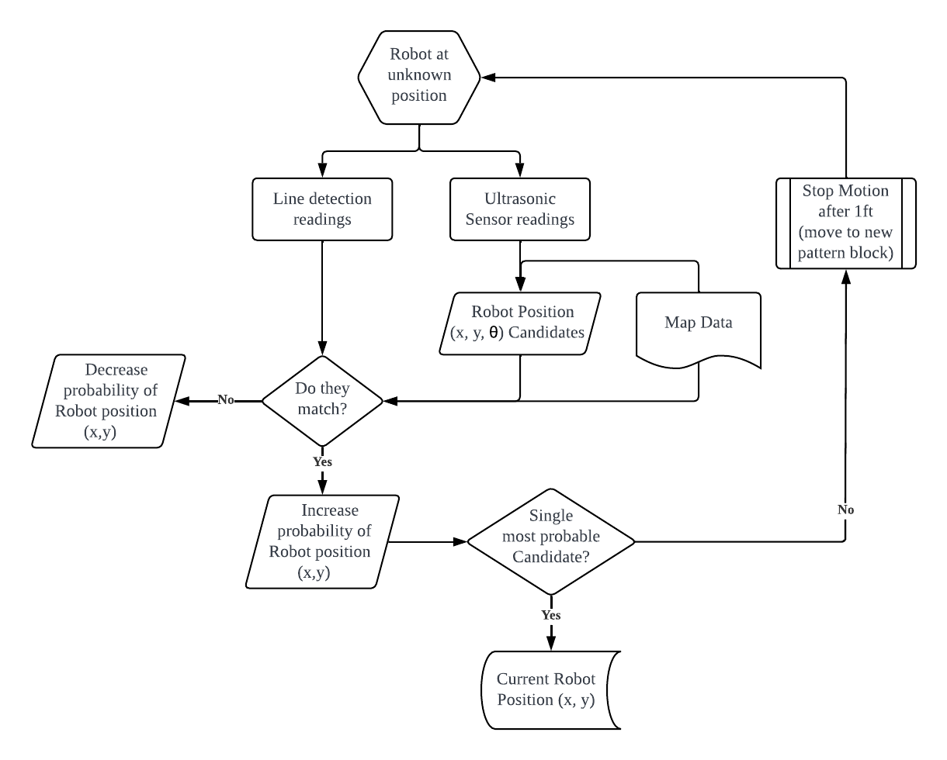
Localization
Notes:
At desired orientation, rover reads four distances that will be compared to map data, generating candidates of robot position.
For each candidates, there will be expected map pattern which will be compared to line sensor readings to evaluate each candidate’s probability.
In cases of multiple equally probable candidates, rover will translate by 1 block to obtain new readings to re-evaluate candidates of position.
Once there is a unique candidate, that will be identified as the current robot position.
45s

Slide 11
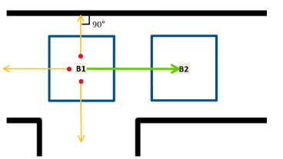
Obstacle Avoidance - Translation
Moves robot Forward/Backward
Steps:
4 distance measurements from 4 ultrasonic sensors
Assess distances such that robot stays ideally away from obstacles(walls)
Notes:
For any translation, rover will avoid collision by travelling through the center of blocks.
Four distance measurements will be used to assess the obstacles surrounding robot.
Based on the measurements, robot will steer accordingly such that it is ideally away from all the walls.
45s

Slide 12
Motion Planning
Use MatLab to find different paths that can lead to the goal position
Choose the shortest path
Convert the shortest path to motion commands to the robot
Notes:
15s

